Slide 1
Predicting Game Worth:
Exploring Insights with Predictive Modeling
By: Tarina Danny Mingjun Victor

Slide 2
01
02
Primary
Secondary
Research Goals
Build a predictive model to determine game worthiness in new datasets
Identify the most reliable model for interpreting game dataset variables
Notes:
30’

Slide 3
Motivation
-Financial Consideration
-Utility for Stakeholders
-Development Aid
Predictive model assists devs, publishers, and marketers in anticipating game response pre-launch
High game development costs require maximizing success chances
A predictive model could help developers refine or enhance game concepts, especially when objectives are unclear
Notes:
Knowing how people react to a game helps stakeholders manage and have control over their sales and brand reputation.
Game development cost usually ranges from $20k to $5 million depending on the complexity. The cost covers design, development, marketing, distribution, etc.
30’

Slide 4
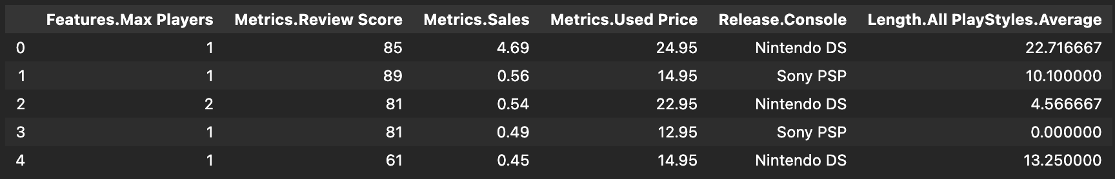
The Dataset: video_games.csv
Source:
Provided by Dr. Ellison
Initially collected by Dr. Joe Cox for games from 2004 to 2010
Data Description:
Length.All PlayStyles.Average: Average time to complete the game across all play styles in hours.
Notes:
30‘

Slide 5




Cleaning the
Dataset
Reduced the dataset to the six variables of interest
No explicit or implicit missing values
Turned the 'Score' column binary: scores over 75 got 1, under 75 got 0
Many outliers present:
Used Price: $30 >
Sales: $6M >
Length: 0min <
Notes:
30’

Slide 6
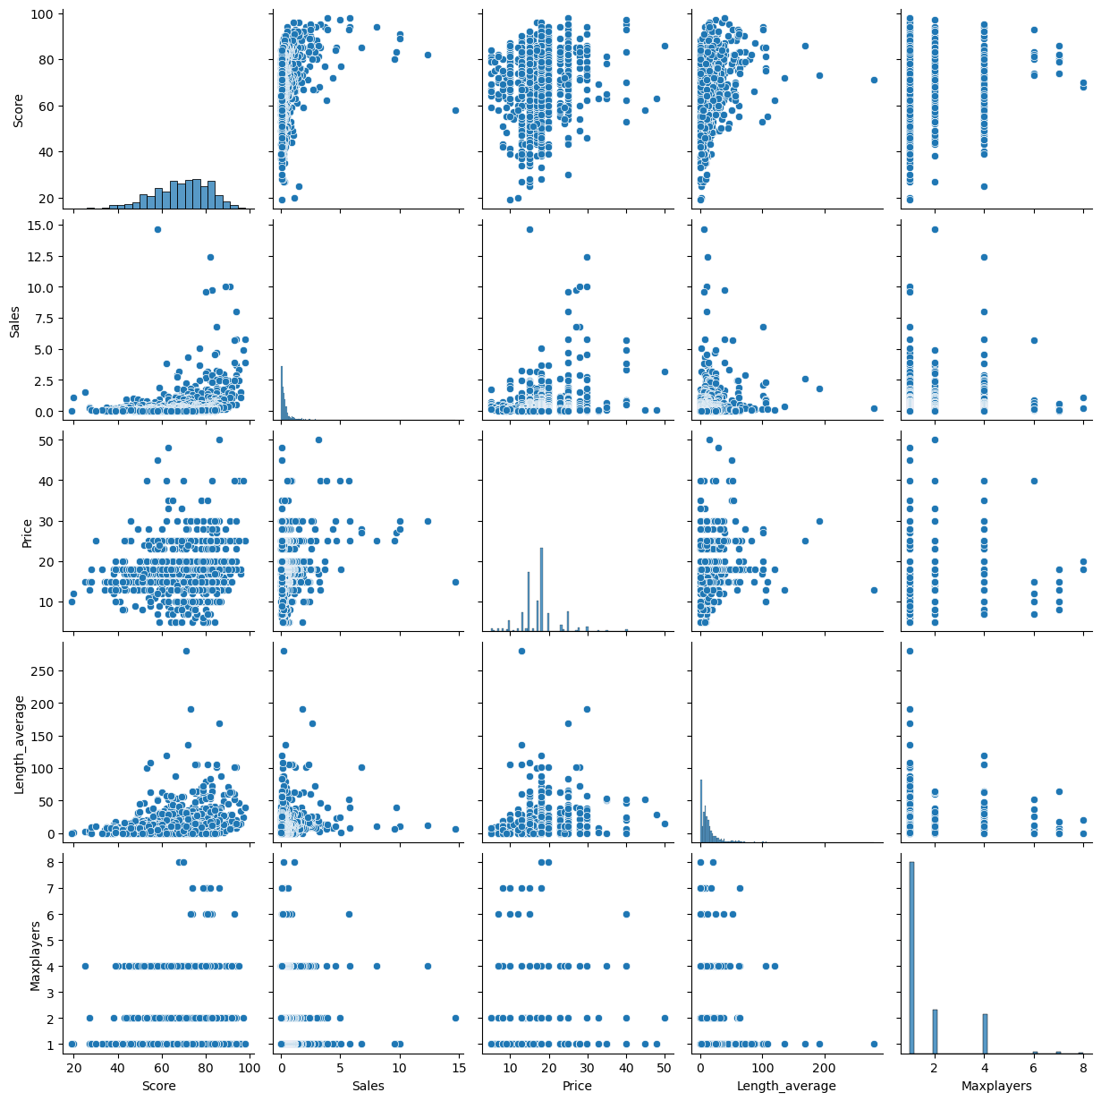
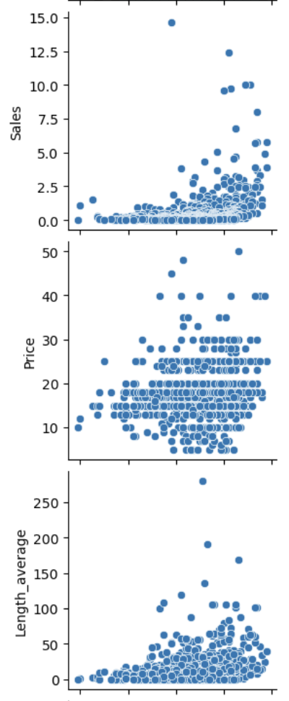
Visualization
Outlier Detection
Multicollinearity
Nature of correlation
Notes:
First click, focuses on three plots to highlight the outliers. For price we kept anything less than $30M….
Second click, focuses back to all plots for general talk of multicollinearity and nature of correlation.

Slide 7
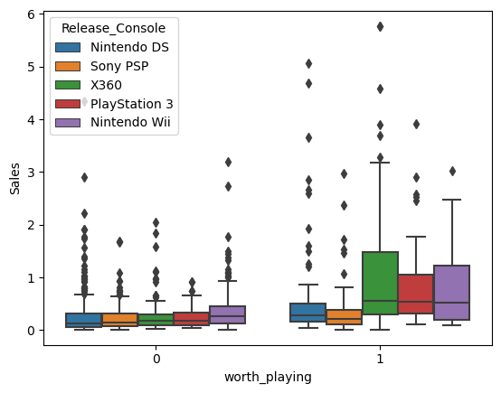
Visualization
Console & Sales show the strongest association with the response variable Worth playing, with varying IQR boxes indicating their influence on game worthiness.

Slide 8
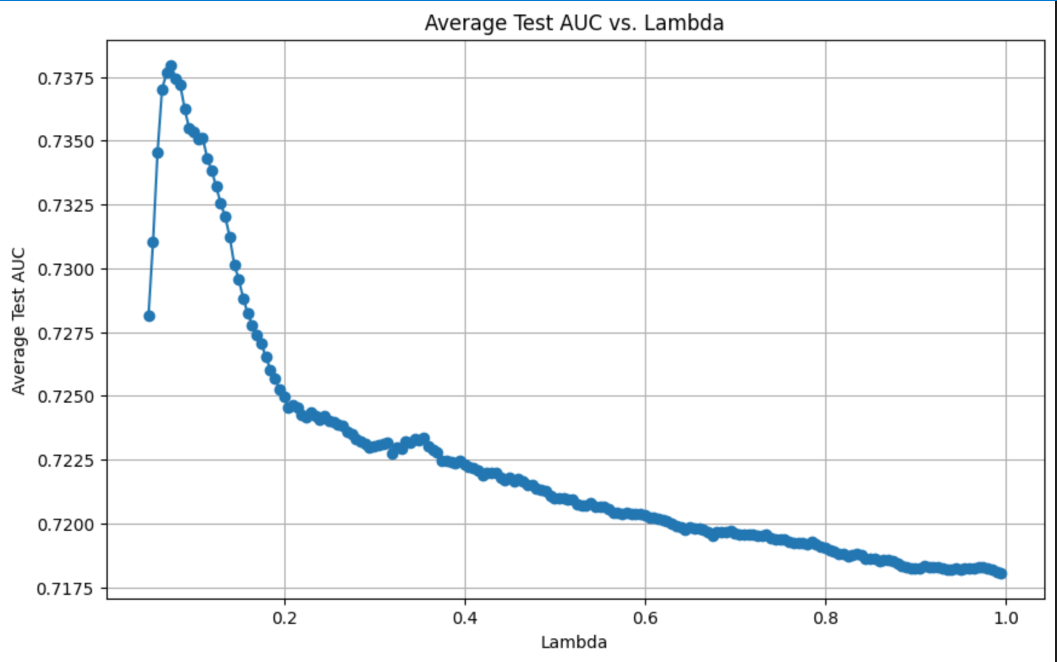

Model Selection
Step1
Step2
LASSO Model
Test Lambda
Vertical comparison of different Lambda
Show variables with less predictive power
0.05 - 1, difference of 0.005
0.075 Lambda performed the best
Notes:
1’

Slide 9
Best Model
No Significant difference
STD is also low: .014 for full model & .019
 | Avg AUC
FULL MODEL | 0.7188
BEST MODEL | 0.7379
DIFFERENCE | .0191
៱
P(worthplaying = 1) = -0.681797
0.792872 * Sales
0.045983 * Price
0.470179 * Length_Average
0.003175 * Maxplayer
0.859503 * Release_Console[Nintendo_Wii]
0.663171 * Release_Console[PlayStation3]
0.335394 * Release_Console[Sony_PSP]
0.391293 * Release_Console[X360]
Notes:
1’

Slide 10
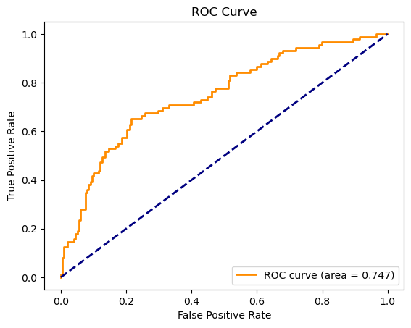
For reference, Here is our ROC Curve

Slide 11
Model Takeaways
After ROC curve analysis, optimal threshold of .655
Strongest: Sales & Release Console
No correlation exceeded 0.7
TPR: 65.56%
TNR: 78.4%
Slope
Multicollinearity
Sensitivity
Specificity

Slide 12
Conclusion
Predict if a game is worth playing
Help developer to learn the market better
Goal Setting and Motivation
Recommend for this era, not for newer games.
Recommend?
Data is from 2004-2010. Consoles and game preferences has shifted.
Shortcomings
Utilize more recent data.
Investigate alternative models and variable selection techniques.
Improvements
Notes:
1’

Slide 13
Thank you for listening

